Slide 1
OpenGL Pipeline
Hosein Ghahremanzadeh
Notes:
The background is a sample of volumetric lighting in my own 3D graphics engine, HG3D

Slide 2

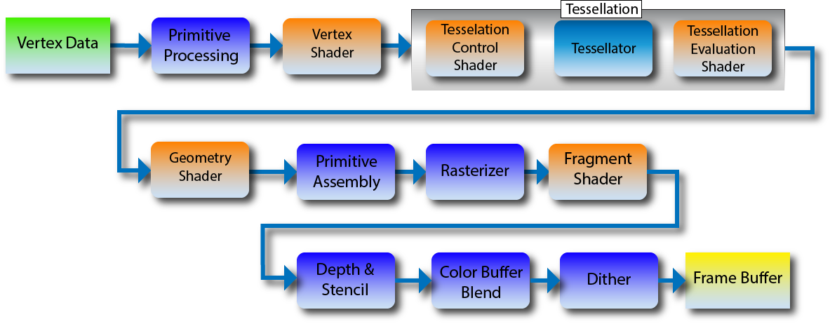
Fragment shader

Slide 3
Fragment shader
Fragment shader runs per fragment.
Fragment shader get a fragment as input.
Fragment shader outputs a set of colors and a depth value and a stencil value.
Fragment shader is optional.
Fragment shader receives interpolated value from the previous stage.
Notes:
The fragment shader runs on each fragment and its input is a fragment, the window space coordinates of the fragment is available in the shader.
Fragment shader output a set of colors, meaning it can be more that one color (that will be store in several matrices, discussed later on), and a depth value, if the depth value is not modified the depth calculated for the fragment from the previous stages, is passed.
Fragment shader is optional, and if not used, the color and stencil values will be undefined. However the depth value (calculated on rasterization) will be unchanged.
All the values that are passed through the previous stages are interpolated for each fragment and are available for in the fragment shader.

Slide 4
Depth & Stencil

Slide 5
Stencil
Stencil is an integer value for each fragment.
To use stencil, stencil buffer is needed.
Stencil test, compares the stencil value of the fragment with current value in the buffer.
If the test fails the fragment is culled.
The test is always done after the fragment shader.
Stencil buffer can be modified even by discarded fragment,
Notes:
The stencil value has a certain bitdepth.
The frame buffer should have a stencil buffer.
Depth test can be:
Never
Always
Less
Less or equal
Greater
Greater or equal
Equal
Not equal
The fragment shader will assign a stencil value for each fragment so it’s not possible to do the stencil test before the fragment shader is run.
Each of the following operations can be applied to stencil buffer after the stencil test. (different operations can be set for failure and success cases of the test, independently)
Keep
Zero
Increment
Decrement
Inver
Replace
Increment and wrap
Decrement and wrap
The depth test is (normally) done after the stencil test, meaning the stencil buffer will be modified even if the depth test fails and the fragment is discarded.
A scissor test also happens before the stencil test.

Slide 6
Depth
In 3D images things behind opaque objects are not seen.
Fragments behind opaque fragments should be culled.
This is done through a depth test.
Depth test compares fragment’s depth with current depth value in the depth buffer
Depth test is usually done after the fragment shader.
Notes:
We need to cull the fragments that are not visible through our PoV.
This is done through a depth test. Depth test can be enabled or disabled.
On depth test the depth value of the fragment is compared to depth value in the depth buffer. If the comparison fails the fragment is call, other wise it’s applied to the frame buffer and depth buffer.
Depth test can be:
Never
Always
Less
Less or equal
Greater
Greater or equal
Equal
Not equal
Depth test is usually done after the fragment shader, though on version 4.5 (not available on 3.3) it is possible to do the test before the fragment shader is run.
This is more performant since the fragment shader will not run on culled fragments.
In the case of early test, if the fragment shader discard the fragment, the depth buffer will still be modified. Also in this case if the fragment shader modifies the depth output this modification is ignored.

Slide 7
Color buffer and blend

Slide 8
Color buffer and blend
In this stage the color output of the fragment shader is applied to color buffer.
If blending is disabled, the new color value from the fragment replaces the old value in the color buffer.
If blending is enabled, different blending equations can be applied.
The blending equations, use the current color value in the buffer and the current fragment’s color value.
Notes:
The way this vale is applied depends on blending and the blending equation.
If blending is disabled, in the case on one to one correlation of the fragment and the matrix cell, the value in the color buffer is replaced with the new value from the fragment shader. All this is if the previous test are passed, and the fragment shader has not discarded the fragment.

Slide 9

Blend operations
Add: $Src + Dst$
Subtract: $Src − Dst$
Reverse Subtract: $Dst − Src$
Min: $Min(Src, Dst)$
Max: $Max(Src, Dst)$
Notes:
$$Dst=DstRGB×DstAlpha$$
$$Src=SrcRGB×SrcAlpha$$
Each of the $DstRGB$ and the $SrcRGB$ can be one of the followings:
Color buffer’s RGB value
Fragment’s RGB value
One minus color buffer’s RGB value
One minus fragment’s RGB value
Zero
One
Each of the $DstAlpha$ and the $SrcAlpha$ can be one of the followings:
Color buffer’s alpha value
Fragment’s alpha value
One minus color buffer’s alpha value
One minus fragment’s alpha value
Zero
One

Slide 10
Dither

Slide 11
Dither
Dithering is used to increase the detail using limited color palette size image.
Notes:
It’s possible to enable dithering on OpenGL, and is useful on low bitdepth colors.

Slide 12
Frame buffer

Slide 13
Frame buffer
Frame buffer is a collection of the buffers.
The result of the rendering is stored in the frame buffer
A frame buffer can have multiple color buffers
There are two types of frame buffers.
Notes:
All the buffers that the result of the rendering is stored in, will be attached to the framebuffer.
There are two types of frame buffers:
Default frame buffer: Which is associated with the window, and rendering to it will be visible on the window.
Frame buffer objects: Which are not associated with any window and rendering to them will not have any direct visible effects.

Slide 14
Write Mask
Write mask can prevent certain value to be written on certain buffers.
Each buffer has a write mask.
On color buffer each of R, G, B, and Alpha values have separate write mask.
Notes:
Write mask occurs before the data is written to frame buffer.

Slide 15
Your questions

Slide 16
Helpful links
https://www.khronos.org/opengl/wiki/Fragment_Shader (Fragment shader)
https://www.khronos.org/opengl/wiki/Stencil_Test (Stencil test)
https://www.khronos.org/opengl/wiki/Depth_Test (Depth test)

Slide 17
Further read
https://www.khronos.org/opengl/wiki/Scissor_Test (Scissor test)
https://www.khronos.org/opengl/wiki/Write_Mask (Write mask)
https://www.khronos.org/opengl/wiki/Early_Fragment_Test (Early fragment test)
https://en.wikipedia.org/wiki/Dither (Dither)
Notes:
https://www.khronos.org/opengl/wiki/Scissor_Test (Scissor test)
https://www.khronos.org/opengl/wiki/Write_Mask (Write mask)
https://www.khronos.org/opengl/wiki/Early_Fragment_Test (Early fragment test)
https://en.wikipedia.org/wiki/Dither (Dither)

